Slide 1
Placement Database Analysis
BY-Aarushi Dua(18csu002)
Abhishek Bhatia(18csu008)
Bhavya Kalra(18CSU045)

Slide 2
CONTENTS
Description
Problem Statement
Problem Analysis

Slide 3
Description
Placement Database is a project based on the GUI .
This is a project based on the visual representation of Placement done in the NorthCap University throughout the years 2015-2016, 2016-2017 and 2017-2018
The package imported are pandas, matplotlib and numpy library

Slide 4
Problem Statement:
The problem is to find the differences between the recruiting done between the years.
It is easier to maintain and view or explain the databases or records of the data stored in different tables in a single format for anyone, keeping that thing in mind, we have created an efficient system which will display the visual representation of the PLACEMENT DATABASE
Hence making the things easy for even an non-technical person to understand the Data.
Also saving the details of the latest placement records it will be easy to show maximum, average packages and graphical representation of top ten companies.

Slide 5
Problem analysis
The issue of the program is to showcase differences between placements done in the years
It show the details of latest placement done in the university.
The other problem is to make the visualization very clear and easier for the user to read.

Slide 6
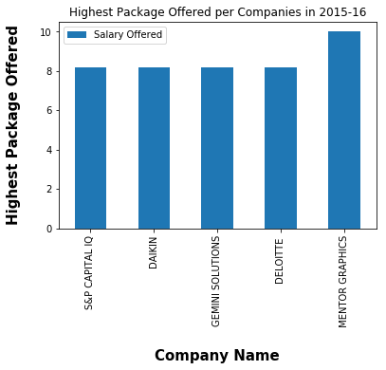
Helps us to analyse highest Package offered by top 5 companies in a particular year.

Slide 7
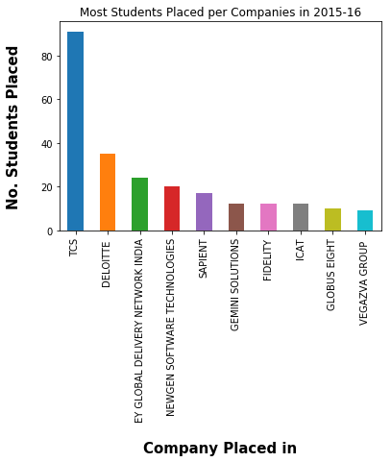
Help us to analyse number of students placed in various companies

Slide 8
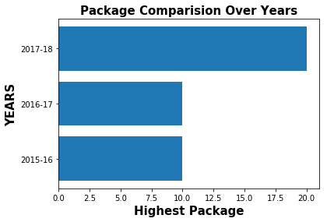
Help us to compare highest package offered in 3 consecutive years

Slide 9
THANK YOU

